Slide 1
Buddy Against Cyber Bullying
PIP2001 Capstone Project
Review-1
Batch Number: CDV-G07
Roll Number | Student Name
20211CDV0012 | Nishad Babu Sulikeri
20211CDV0011 | Ganesh V Hegde
20211CDV0029 | Dinesh Kumar Reddy M
20211CDV0030 | K Vamsi Krishna
20211CDV0004 | Manishimha G
Under the Supervision of,
Ms. Ashishika Singh
Professor, School of Computer Science and Engineering
Presidency University
Name of the Program: B.Tech – Computer Science and Technology (DevOps)
Name of the HoD: Dr. S Pravinth Raj
Name of the Program Project Coordinator: Suma N G
Name of the School Project Coordinators: Dr. Sampath A K / Dr. Abdul Khadar A / Mr. Md Ziaur Rahman

Slide 2
Introduction
Cyberbullying is a form of harassment on a social/online platform. It has become very common, especially among teenagers. Our Website: Provides instant help through a user-friendly chatbot (“Billy”) which not only comforts the victim but also reports the person behind, to the cyber-crime department keeping the user’s identity anonymous. It will provoke the victim to provide important information and evidences. It will also calculate the statistics of cyber-crimes in an area visible to the cyber crime department to keep a track of crimes on a regular basis. The areas with red alert will be given more focus in any part of the country. Tips and defense tactics would be mentioned on the website to guide the youth and others. All the data will be kept anonymous so that it cannot be used in a negative way
Through the integration of Natural Language Processing (NLP), sentiment analysis, and entity recognition, Billy identifies key details about bullying incidents while ensuring user anonymity.

Slide 3
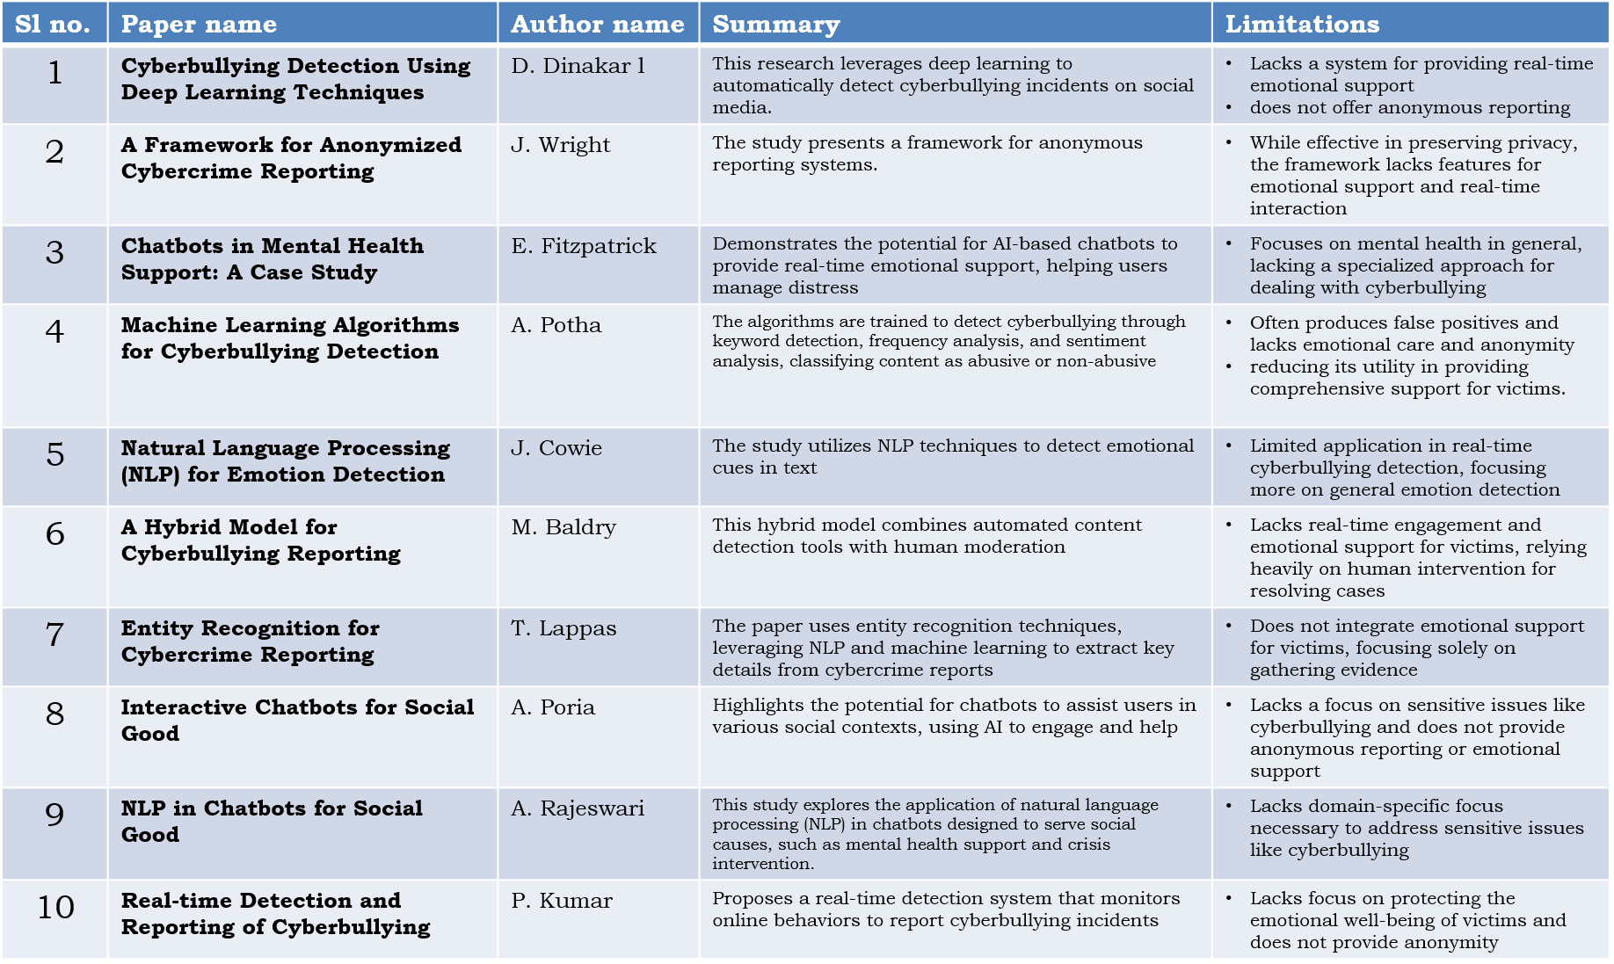
Literature Review

Slide 4
Existing method Drawback
Manual Reporting Systems
Drawback: Often cumbersome and time-consuming. Victims may hesitate due to lack of anonymity.
AI-based Moderation Systems
Drawback: These systems focus on content moderation but don’t provide emotional support or guidance to victims.
Social Media Keyword Filtering
Drawback: Inefficient due to high rates of false positives, especially when detecting subtle forms of bullying.
Anonymous Reporting Tools
Drawback: Lack of integration with emotional support and poor guidance in the reporting process.

Slide 5
Proposed Method
Website: Create a website using React and tailwind CSS, where the chatbot will be implemented and all other modules will be added.
Chatbot: Create conversational flows using Botpress, where "Billy" greets the user, provides emotional support, and prompts for incident details.
NLP Integration: Use NLP to detect user intent (emotional support or incident reporting) and extract key entities (time, place, persons involved).
Anonymization: Implement a system to anonymize all user data before storing it or sending reports to law enforcement.
Real-time Reporting: Send anonymized reports to the cyber-crime department through secure APIs.
Data Collection and Analysis: collect data on reported incidents, providing real-time statistics on cyberbullying cases by region.

Slide 6
Objectives
Provide Emotional Support: Develop a chatbot that offers real-time, empathetic support to victims of cyberbullying, addressing the emotional distress caused by the incidents.
Anonymous Reporting: Ensure complete anonymity for victims reporting cyberbullying incidents to the relevant authorities.
Improve Accuracy in Cyberbullying Detection: Utilize NLP and machine learning to accurately detect cyberbullying incidents, reducing false positives and negatives.
Generate Regional Crime Statistics: Provide law enforcement with real-time statistics on cyberbullying incidents, enabling them to focus on high-risk areas.

Slide 7
Methodology/Modules
User Interaction Module
Handles the chat interface and emotional support messages based on NLP-driven intent detection.
Incident Reporting Module
Gathers and anonymizes details about the incident, such as time, place, and involved individuals.
Anonymization Module
Strips identifying information from reports before sending them to authorities.
Data Analysis Module
Analyzes reported incidents for trends and generates red-alert regions based on cyberbullying frequency.
API Integration Module
Interfaces with law enforcement systems to forward reports and statistical data securely.

Slide 8
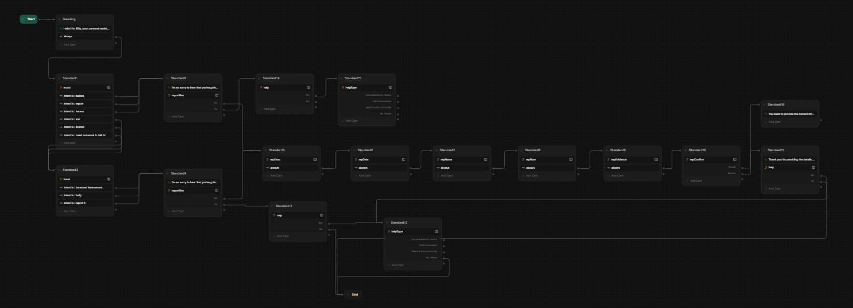
Architecture

Slide 9
Hardware/software components
Hardware:
Any system capable of supporting AI-based software.
Software:
Botpress: For developing the chatbot’s conversational flows.
Python: For scripting machine learning algorithms and NLP tasks. And data Analysis
NLP: for entity recognition and intent detection.
Database: MySQL or MongoDB for storing anonymized user reports.

Slide 10
Timeline of Project
REVIEW 0
REVIEW 1
DESIGN
REVIEW 2
BUILD
REVIEW 3
TEST
PLAN
17/09/2024
FINAL VIVA VOCE
REVIEW
18/10/2024

Slide 11
Expected Outcomes
Increased Incident Reporting: Anonymity and emotional support will encourage victims to report cyberbullying incidents more frequently.
Accurate Detection of Cyberbullying: The integration of NLP and machine learning will significantly reduce false positives, ensuring that only genuine incidents are flagged.
Geographical Crime Data: The chatbot will help law enforcement agencies by providing real-time statistics, highlighting regions where cyberbullying is prevalent.
Psychological Well-being of Victims: Providing immediate emotional support will contribute to improved mental health outcomes for victims of cyberbullying.

Slide 12
Conclusion
The proposed system, "Billy," provides a novel solution to combat cyberbullying by combining emotional support with an anonymous reporting system. By leveraging AI, NLP, and anonymization, this project addresses the shortcomings of existing cyberbullying detection methods, ensuring victims' safety and encouraging higher reporting rates. The statistical analysis module offers valuable insights for law enforcement, helping them respond more effectively to cyber-crime.

Slide 13
Github Link
https://github.com/Nishu4403/billy

Slide 14
References
Dinakar, D., Jones, B., & Havasi, C. (2012). "Cyberbullying Detection Using Deep Learning Techniques." International Conference on Web Intelligence and Intelligent Agent Technology (WI-IAT). DOI: 10.1109/WI-IAT.2012.71
Wright, J., Martinez, L., & O'Brien, K. (2014). A Framework for Anonymized Cybercrime Reporting. Journal of Information Security and Applications, 19(2), 91-99. DOI: 10.1016/j.jisa.2014.01.001
Fitzpatrick, E., Dwyer, C., & Stokes, N. (2016). Chatbots in Mental Health Support: A Case Study. Proceedings of the International Conference on Health Informatics. DOI: 10.5220/0005632402830290
Potha, A., & Maragoudakis, M. (2017). Machine Learning Algorithms for Cyberbullying Detection. International Journal of Advanced Computer Science and Applications, 8(1), 240-246. DOI: 10.14569/IJACSA.2017.081240
Cowie, J., & Cornelius, N. (2010). Natural Language Processing for Emotion Detection. IEEE Transactions on Affective Computing, 1(1), 97-107. DOI: 10.1109/TAFFC.2010.15
Baldry, M., & Jansen, R. (2018). A Hybrid Model for Cyberbullying Reporting. Computers in Human Behavior, 89, 289-294. DOI: 10.1016/j.chb.2018.02.001
Lappas, T., & Mustafaraj, E. (2019). Entity Recognition for Cybercrime Reporting. IEEE Transactions on Information Forensics and Security, 14(8), 2100-2109. DOI: 10.1109/TIFS.2019.2892318
Poria, A., Cambria, E., & Gelbukh, A. (2015). Interactive Chatbots for Social Good. Proceedings of the International Conference on Computational Linguistics (COLING), 181-187. DOI: 10.5555/2858916.2859016
9. Patchin, C., & Hinduja, S. (2014). Cyberbullying Prevention Tools in Schools. Journal of School Violence, 13(1), 1-19. DOI: 10.1080/15388220.2014.893857
10. Kumar, P., & Joshi, P. (2020). Real-time Detection and Reporting of Cyberbullying. IEEE Access, 8, 72942-72951. DOI: 10.1109/ACCESS.2020.2987565

Slide 15
Thank You

